Slide 1


Healthcare
Analytics Summary
Presentation by:
Thambidurai Sundaramoorthy
info@healthcare.com
+123-456-7890
www.healthcare.com

Slide 2

Introduction
Domain:
The healthcare domain focuses on delivering quality medical services to patients through accurate diagnoses and effective treatments. Doctors, specialists, and healthcare professionals collaborate to manage appointments, provide consultations, and ensure proper care. They have specialized doctors in Orthopedics, Pediatrics, Cardiology, General Medicine and Neurology. Advancements in healthcare systems enhance patient experiences, improving overall health outcomes.
Project:
The project is to analyze healthcare data, focusing on extracting meaningful insights about patients, doctors, appointments, diagnoses, and treatments using advanced SQL techniques and more to analyze healthcare metrics.

Slide 3

Objective
Business use cases:
To analyze patient demographics, their medical histories, and appointment trends.
To measure doctor efficiency by tracking diagnoses and treatment frequency.
To understand appointment trends, cancellations, and completions.
To identify most common medications prescribed to patients based on diagnoses.

Slide 4
Overview
5000 Patients
2519 Female and 2481 Male patients
4338 Patients with appointments
4739 Patients with diagnoses
2660 Patients undergone medications
Patients
300 Doctors
Specialized in Cardiology, General Medicine, Neurology, Orthopedics & Pediatrics
Doctors
10000 Appointments
3392 Completed
3334 Cancelled
3274 Scheduled
Reasons - Checkup, Consultation, Emergency, Follow-up & Test Results
Appointments
15000 Diagnoses
Diagnoses - Diabetes, Flu, Fracture, Hypertension & Migraine
Treatments - Lifestyle Changes, Medication, Observation, Surgery & Therapy
Diagnoses
12000 Medications
Medications - Antibiotics, Antidepressants, Insulin, Painkillers & Paracetamol
Dosages - Once Daily, Twice Daily, Thrice Daily & Weekly
Medications

Slide 5
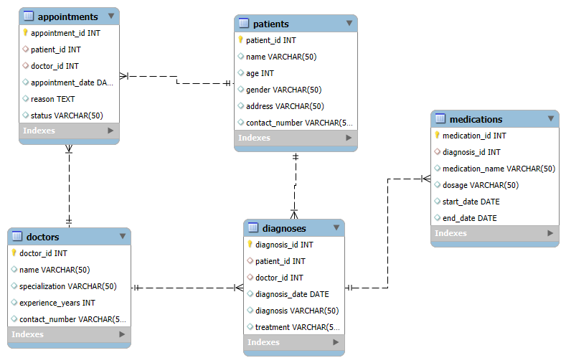
ER Diagram

Slide 6

Tasks Summary - 1
Task 1
All completed appointments
Totally, 10000 appointments were scheduled out of which 3392 appointments (34%) have been completed where as 3334 appointments (33%) have been cancelled and 3274 appointments (33%) have been scheduled.
Doctor_143 who is specialized in Pediatrics have 21 the most completed appointments.
There are 5 patients with the maximum appointments completed which is of 5 appointments.
Task 2
Patients who never had an appointment
Totally, there are 5000 patients out of which 662 patients didn’t had any appointment ever which is of 13% from the overall patients list.
It includes 318 Male patients and 344 Female patients.

Slide 7

Tasks Summary - 2
Task 3
Number of diagnoses for each doctor
Totally, 15000 diagnoses have been completed for 4739 unique patients.
All the 300 doctors have diagnosed the patients.
Doctor_281 specialized in Orthopedics have the highest diagnoses of 75.
Doctor_253 specialized in General Medicine have the lowest diagnoses of 25.
Task 4
Identify mismatches between the appointments and diagnoses tables
There were 86 mismatches between the appointments and diagnoses tables.
As MySQL does not support full outer join used union of left join and right join instead for this task.

Slide 8

Tasks Summary - 3
Task 5
Patients rank based on the no. of appointments for each doctor
The maximum appointment for a single doctor with the same patient is 2.
36 doctors had maximum of 2 appointments with the same patients and they ranked their patients 1.
Task 6
Categorize and number of patients by age group
An age group has been formed and categorized the total number of patients in the particular age group in the below-table as follows:
Age group | Total Patients
18 to 30 | 900
31 to 50 | 1416
51 to 70 | 1372
71 to 89 | 1312

Slide 9

Tasks Summary - 4
Task 7
List of patients whose contact numbers end with "1234
Patient_1234 is the only patient who has a contact number that ends with “1234”.
The Patient name has been updated in the upper case in the SQL query.
Task 8
Find patients who have only been prescribed "Insulin" in any of their diagnoses
Overall, 1784 Patients have been prescribed with Insulin. Some of the Patients have additional medications along with Insulin.
Only 252 Patients have been prescribed with only Insulin on any of their diagnoses.

Slide 10

Tasks Summary - 5
Task 9
Average duration of days - Medications are prescribed for each diagnosis
The maximum average duration days of 1090 days for an Antidepressants medication is prescribed for the Hypertension diagnosis. This is for the diagnosis id 9729.
The minimum average duration days of -1081 days for an Antidepressants medication is also prescribed for the Hypertension diagnosis. This is for the diagnosis id 9907.
Task 10
Doctors who attended most unique patients
Doctor_37 specialized in General medicine has attended most unique patients of 51.
Doctor_299 specialized in Pediatrics has attended less unique patients of 21.

Slide 11


Business Insights - 1
Patients Management
Patient Demographics:
Age Distribution: Majority of patients falls within the age group of 31 to 50, followed by 51 to 70 and 71 to 90 age groups.
Gender Ratio: Female patients slightly outnumber male patients, with a 50.4% to 49.6% split.
Medical Histories:
Diagnoses: 20.3% of patients suffer from migraine followed by Flu with 20.1%.
Treatment: 20.6% of patients prescribed with Therapy treatment.
Appointment Trends:
Monthly Trends: Appointment volumes peak in May to August and December & January, possibly due to seasonal illnesses.
Doctor Workload: Specialists like Cardiology & Pediatrics handled more than 20% patients than other specialists.
Cancellation Rate:: 33.3% of appointments were cancelled and maximum appointments cancelled was Follow-ups.

Slide 12

Business Insights - 2
Doctor Performance Evaluation
Diagnosis Tracking:
The average diagnoses for each Doctor is 50.
The Doctors who handled specific diagnoses the most are listed below:
 | Diabetes | Flu | Fracture | Hypertension | Migraine
Doctor_id | 4 | 281 & 79 | 230 | 243 | 214
No. of Diagnoses | 21 | 19 | 20 | 2 | 23
Treatment Efficiency:
The Doctors who prescribed certain medications the most are listed below:
 | Antibiotics | Antidepressants | Insulin | Painkillers | Paracetamol
Doctor_id | 46 & 247 | 140 & 236 | 230 | 4 | 41
No. of Times | 18 | 20 | 17 | 18 | 18
Appointment Efficiency:
The scheduled appointments average is 33%.
Doctor_143 has the highest completion of 21 appointments being completed.
Doctor_37 has the highest cancellation of 23 appointments being cancelled.

Slide 13

Business Insights - 3
Appointment Scheduling & Completion:
Appointment Trends:
Monthly Variations: Appointment volumes peak in May to August and December & January, possibly due to seasonal illnesses.
Doctor Specific Trends: Specialists like Cardiology & Pediatrics handled more than 20% patients than other specialists.
Follow-up Patients: 20.4% of maximum appointments were for follow-ups.
Appointment Cancellation:
Cancellation Rate:: 33.3% of appointments were cancelled which is one third of the overall appointments.
Reasons: 20.4% of appointments been cancelled were follow-ups.
Specialty Impact: 24.4% of higher cancellation rates for Cardiology compared to other specialists.
Appointment Completion:
Completion Rate:: 33.9% of scheduled appointments were completed where as 32.7% of appointments are in scheduled status.

Slide 14

Business Insights - 4
Medication Analysis
Most Prescribed Medications Overall:
Painkillers is the top most prescribed medication.
Categorized medications based on long-term (Insulin) vs short-term (Antidepressants) use.
Medications by Diagnoses:
The most common prescribed medication for each diagnosis are listed below:
Diabetes - Painkillers
Flu - Painkillers & Antidepressants
Fracture - Antibiotics
Hypertension - Paracetamol
Migraine - Antibiotics
Painkillers and Paracetamol are prescribed across multiple diagnoses, indicating frequent pain management treatments.

Slide 15
Real-Time Analysis
Key Insights:
Efficient appointment scheduling and completion play a crucial role in reducing patient wait times, optimizing doctor availability, and enhancing healthcare outcomes.
Identify high-demand time slots to optimize scheduling and track common reasons for missed appointments. Assess how unscheduled visits affects regular appointments.
Measure correct diagnoses vs. misdiagnoses to improve accuracy and track patient recovery based on prescribed treatments and follow-ups.
Identify frequently occurring diseases and trends (e.g., seasonal flu). Track whether patients follow prescribed dosages. Analyze patient feedback on medications for adverse effects. Understand which medicines are most effective for specific illnesses.
Strategies to improve:
Send SMS, email, or app notifications to reduce no-shows and allow easy rescheduling via mobile apps or online portals.
Assist doctors with real-time diagnosis and treatment recommendations. Reduce paperwork time, allowing doctors to focus more on patient care.
Assist doctors in early disease detection and decision-making. Recommend personalized medications based on patient history. Enable faster consultations for patients in remote areas.

Slide 16


Thank You!
Thambidurai Sundaramoorthy
stdurai95@gmail.com
info@healthcare.com
+123-456-7890
www.healthcare.com

